Slide 1


By
Notes:
Omer Intro

Slide 2

Data Collection- Phosphosites
Phosphosite data was obtained from the PhosphoSitePlus website. The focus was on two available datasets.
Only data that showed the relationship between kinase-kinase and protein-kinase was used.
Data was sorted using various python scripts.
The sorted data was required in order for the PP Tool to run its analysis.

Slide 3
Data Collection- Kinases
Initially the data for kinases was obtained via the Kinase website.
The information obtained included their name, gene symbol, and families they belong to.
Data acquired from the PhosphoSitePlus website, also contained the information regarding the sites that the kinases are known to phosphorylate.
Data was located in one file, however, was missing some key data.

Slide 4

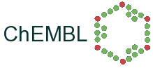
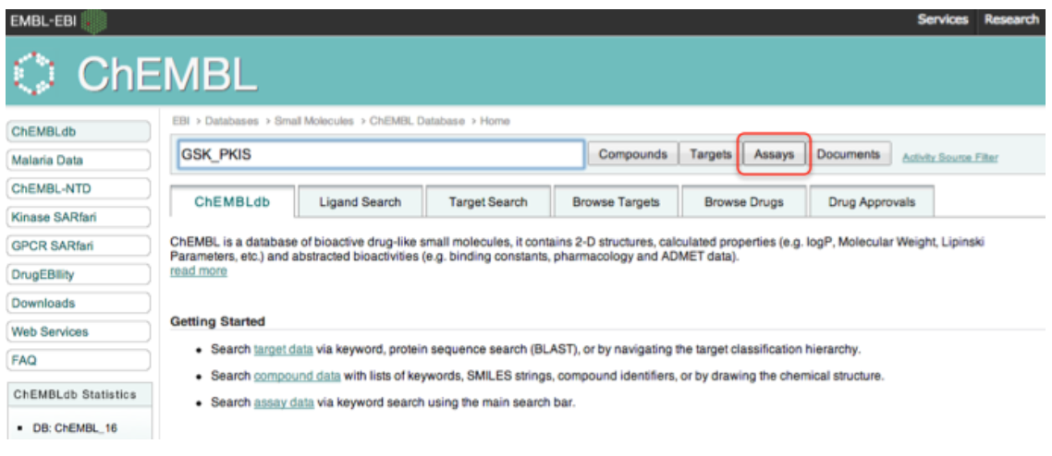
Data Collection
Kinase (Uniprot):
Kinase locations.
Acc ID.
Gene names.
Inhibitor data GSK:
376 Compounds - PKIS dataset
Addition information on structural properties was retrieved from EBI
Image links

Slide 5
Database Construction
Created the database using SQLITE3 through Python
Incorporated the raw CSV files into tables
The tables were joined using the inhibitor and the kinase names
Notes:
At the beginning I used mock data that I gathered from websites to create two separate databases, one for kinase and one for inhibitors but then I changed it to where all the data was placed into one database
So once Omer and Hajar provided me with information I used the raw CSV file to create the tables which were regularly updated. I actually had issue with the inhibitor data because SQLITE3 wouldn't accept the column names, so I had to go and change them and make sure the same names were inserted into the SQLITE3 tables.
I was able to join these tables according to their inhibitor and kinase names.
This database was integrated into the website by Hajar using SqlAlchemy.

Slide 6
Database Integration: FLASK-SQLAlchemy
SQLAlchemy: Python SQL toolkit and Object Relational Mapper.
SQLite 3
Database construction
Initialise Database
Data extraction
Flask-WTF Forms
Simple query
Join query
Models
Generate db Session

Slide 7
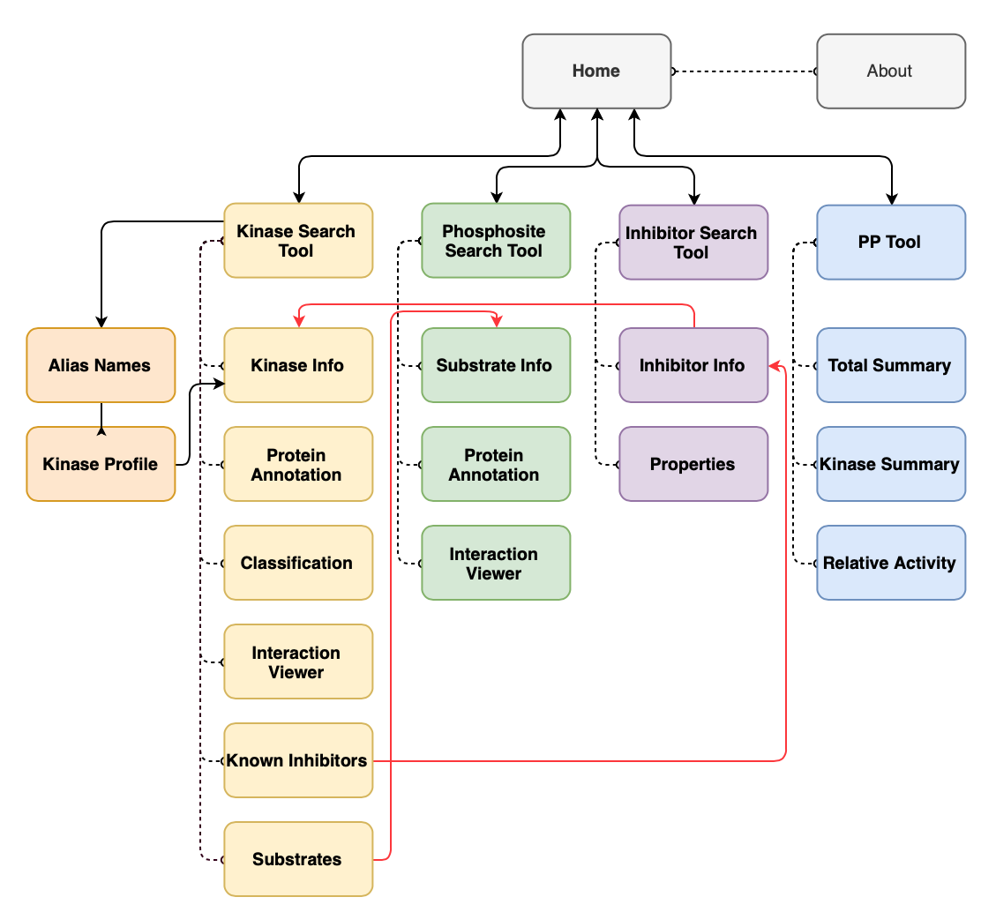
Website Development: Structure
4 Main Routes
Based on three search functions and a data analysis tool.
Red lines show internal hyperlinks.

Slide 8
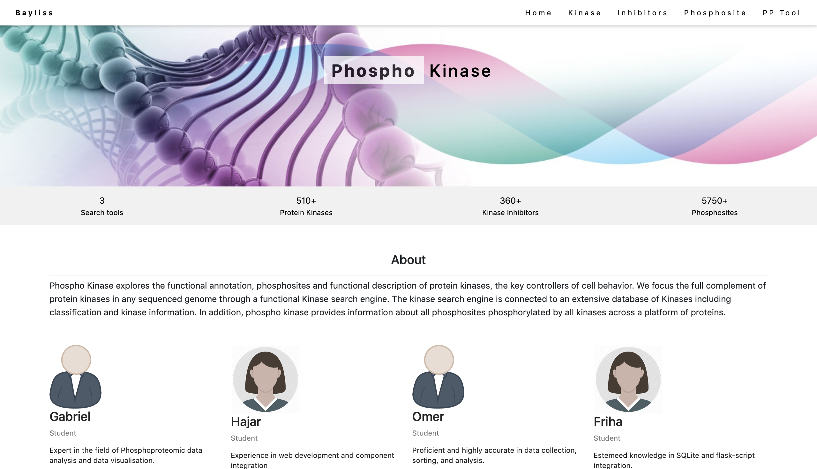
Website Development: HTML and CSS
Simple and professional design that was easy for the user to use and navigate through.

Slide 9
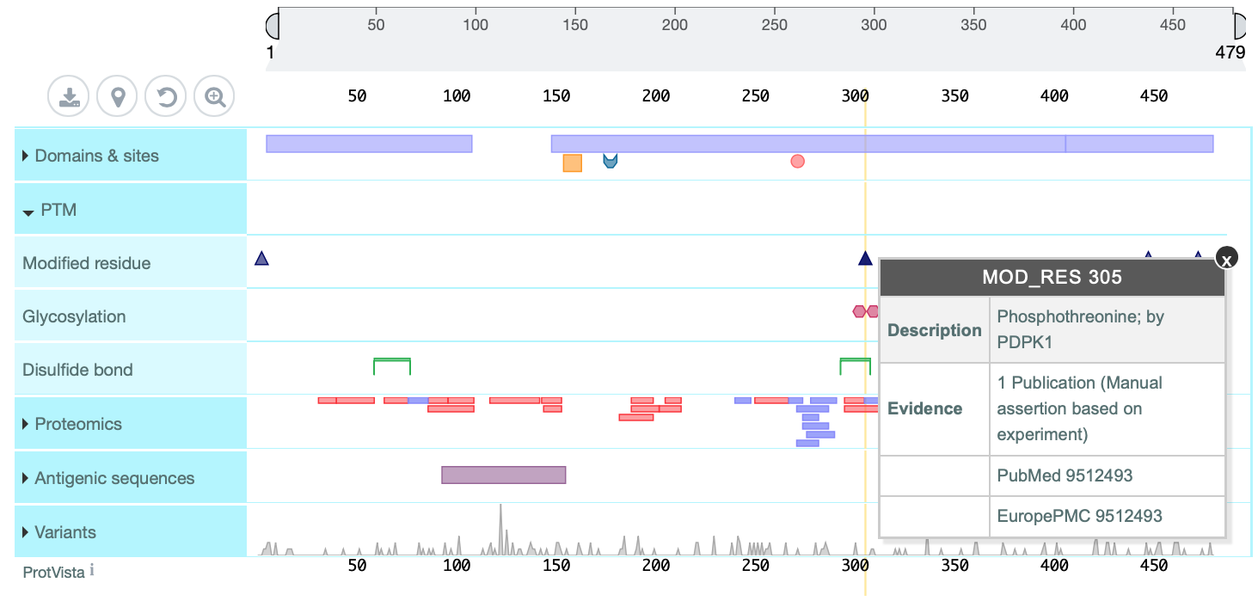
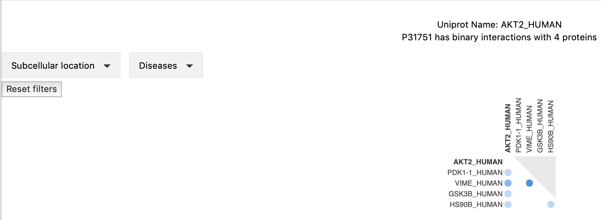
Website Development: Javascript
Integration of various components to create an interactive user experience:
Protein Annotation.
Protein Interaction Viewer.

Slide 10

Phosphosite & Deployment
Worked within already established design elements.
Used SQLAlchemy to query database.
Phosphosite data was visualised using the widget ProtVista.
I then focused on deployment, which was done using the Elastic Beanstalk service provided by Amazon Web Services.

Slide 11
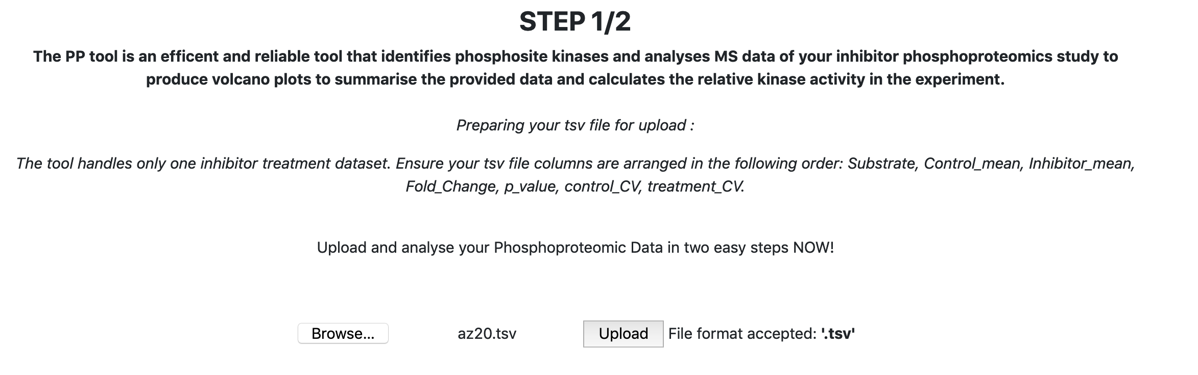
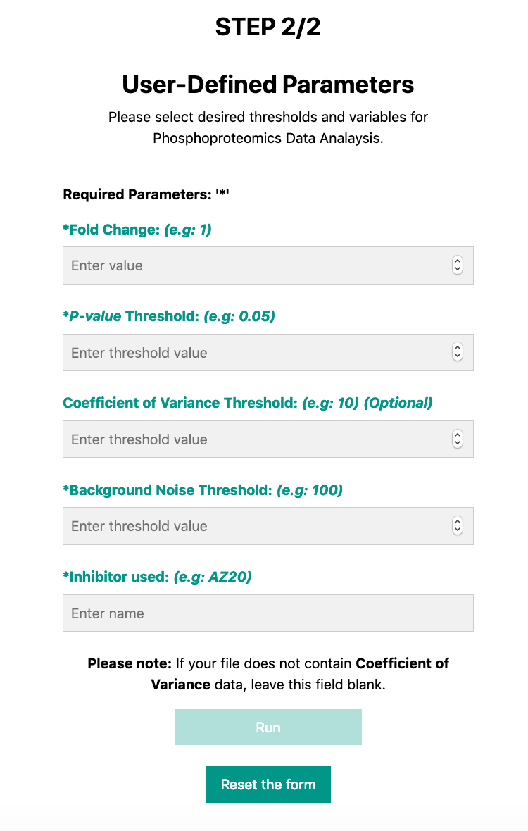
PP Tool Design and Analysis Script integration
Created the ‘file upload’ button
The user file was saved as ‘temp.tsv’ in the static folder
Used HTML and Javascript to create parameters for the user to enter
Used Python and Flask to incorporate the analysis script.
Notes:
My second main target was to design the Phosphoproteomc tool site.
This is where I created the file upload button which allowed the user to browse their pc and upload a tsv file.
From here I made sur that the user’s file is saved as a temp.tsv file in our static folder which made it easier for the analysis script to integrate.
The second step was to create user-defined parameters which were then incorporated into the analysis script for the calculations to work.
To incorporate the analysis script written by Gabriel, I had to make small changes in the Flask main.py file as well as his script.

Slide 12
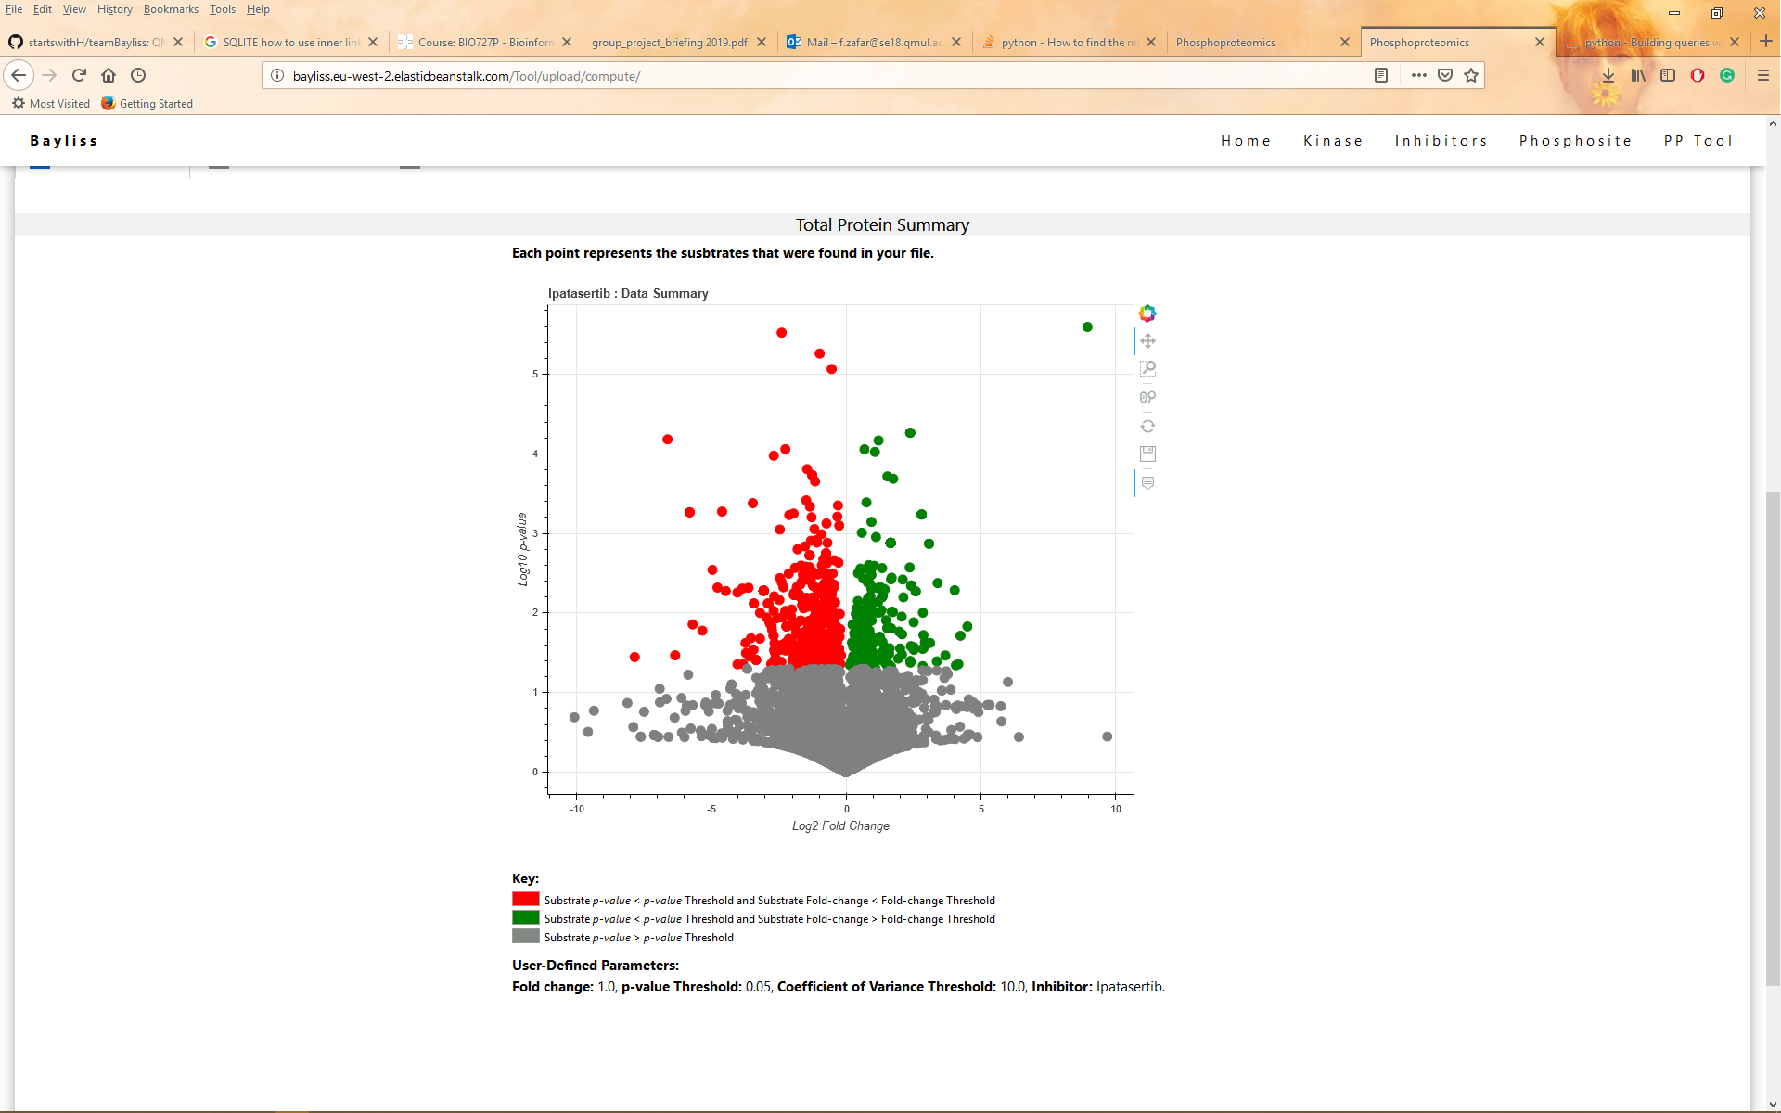
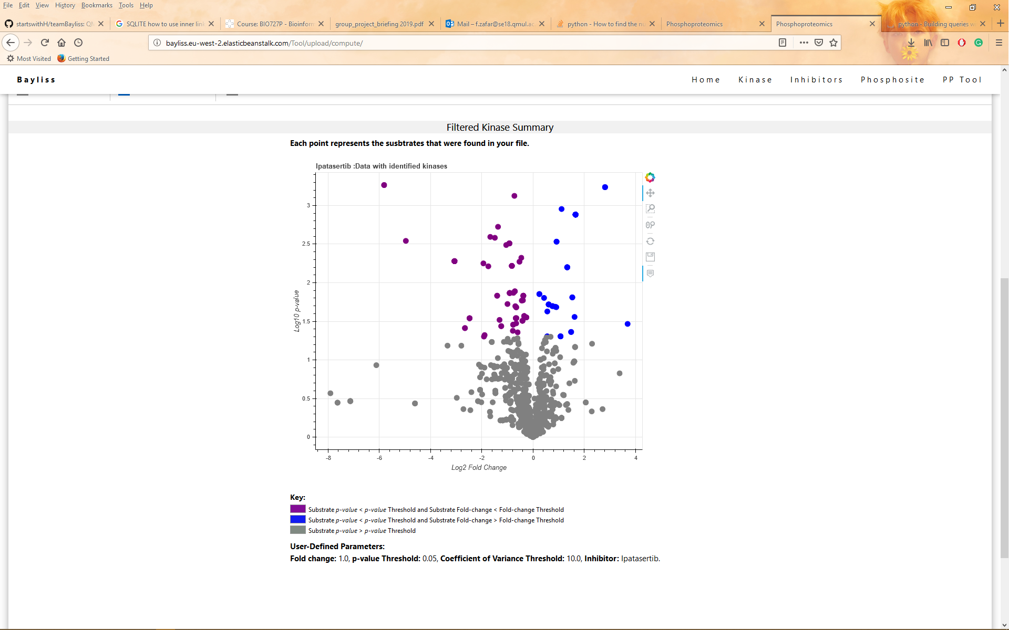
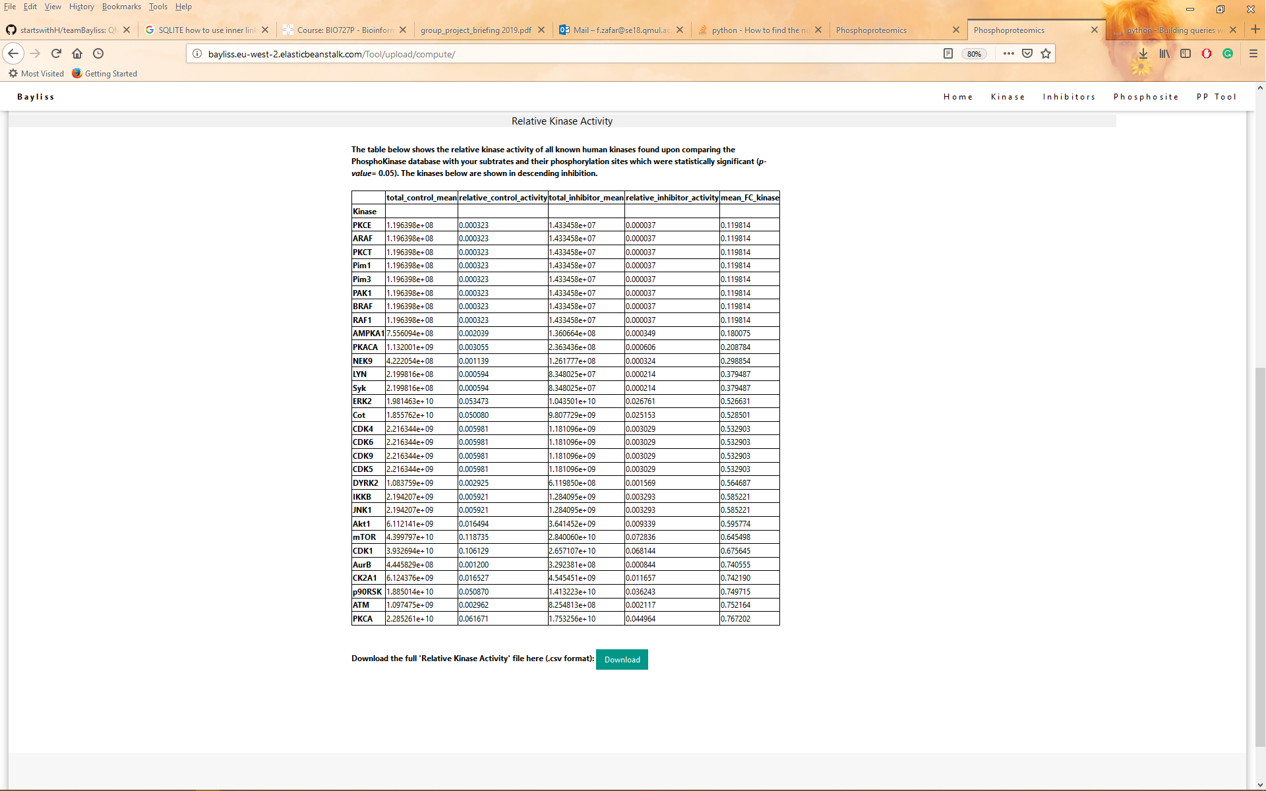
Analysis visualisation
Used Bokeh.embed to visualise the volcano plots onto the website.
Added keys using CSS and axis labels using Bokeh.
Converted the relative kinase activity table into html to display on website.
Created a download link for the user to download the whole table.
Notes:
Once the calculations occur the results had to be visualised.
Luckily, Gabriel used Bokeh which enables embedding into websites making it easier for me.
I was also able to create a ‘relative_kinase_activity.csv’ file for the full table- which is retrieved into static folder.

Slide 13
Volcano Plots
Parameters
Volcano Plots
Notes:
Once the calculations occur the results had to be visualised.
Luckily, Gabriel used Bokeh which enables embedding into websites making it easier for me.
I was also able to create a ‘relative_kinase_activity.csv’ file for the full table- which is retrieved into static folder.

Slide 14
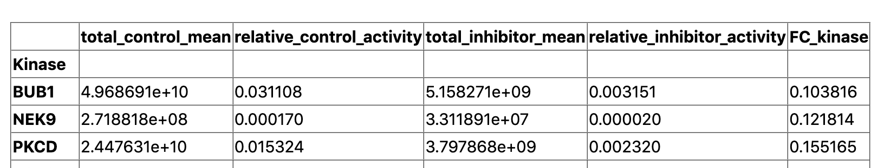
Relative Kinase Activity Table
In the control treatment, is estimated by the sum of the mean phosphopeptide MS1 peak area, matched to an individual kinase, divided by the sum of the mean phosphopeptide MS1 peak areas in the dataset for all kinase-substrate matches.
The sum of mean phosphopeptide MS1 peak areas in the control (untreated) treatment, matched to a kinase.
dd text
Calculated by the Total_Inhibitor_mean divided by the Total_Control_mean for each kinase.
Notes:
Columns
Description
Total_Control_mean
The sum of mean phosphopeptide MS1 peak areas in the control (untreated) treatment, matched to a kinase.
Total_Inhibitor_mean
The sum of mean phosphopeptide MS1 peak areas in the inhibitor treatment, matched to a kinase.
Relative_control_activity
In the control treatment, is estimated by the sum of the mean phosphopeptide MS1 peak area, matched to an individual kinase, divided by the sum of the mean phosphopeptide MS1 peak areas in the dataset for all kinase-substrate matches.
Relative_inhibitor_activity
In the inhibitor treatment, is estimated by the sum of the mean phosphopeptide MS1 peak area, matched to an individual kinase, divided by the sum of the mean phosphopeptide MS1 peak areas in the dataset for all kinase-substrate matches.
FC_kinase
Calculated by the Total_Inhibitor_mean divided by the Total_Control_mean for each kinase.
Columns
Description
Total_Control_mean
The sum of mean phosphopeptide MS1 peak areas in the control (untreated) treatment, matched to a kinase.
Total_Inhibitor_mean
The sum of mean phosphopeptide MS1 peak areas in the inhibitor treatment, matched to a kinase.
Relative_control_activity
In the control treatment, is estimated by the sum of the mean phosphopeptide MS1 peak area, matched to an individual kinase, divided by the sum of the mean phosphopeptide MS1 peak areas in the dataset for all kinase-substrate matches.
Relative_inhibitor_activity
In the inhibitor treatment, is estimated by the sum of the mean phosphopeptide MS1 peak area, matched to an individual kinase, divided by the sum of the mean phosphopeptide MS1 peak areas in the dataset for all kinase-substrate matches.
FC_kinase
Calculated by the Total_Inhibitor_mean divided by the Total_Control_mean for each kinase.

Slide 15
http://bayliss.eu-west-2.elasticbeanstalk.com/

